Slide 1
Harvest DATA Via Twitter API
ZHU RUI
COMM7410

Slide 2
Procedure
Step 0 - Define a Problem
Step 3 - Exploration
Step 1- Target Data
What data can solve your problem
Step 2 - Data Collection
How to get the data
Explore answers from the data
What do you want to know

Slide 3






Step 0 - Define a problem:
how ‘HIV’ is discussed in Twitter
Trend
High frequent words
Active users
Popular tweets
…….
Step 1 - target Data:
Twitter data containing ‘#HIV’
#hashtag: a keyword, an index, a navigation

Slide 4

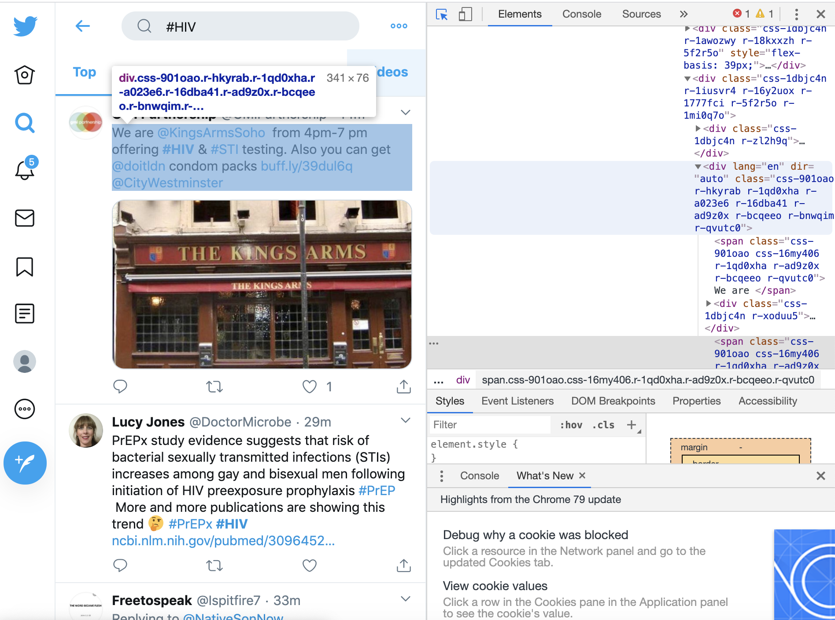
Step 2 - Data Collection
By searching:
By web scraping:

Slide 5
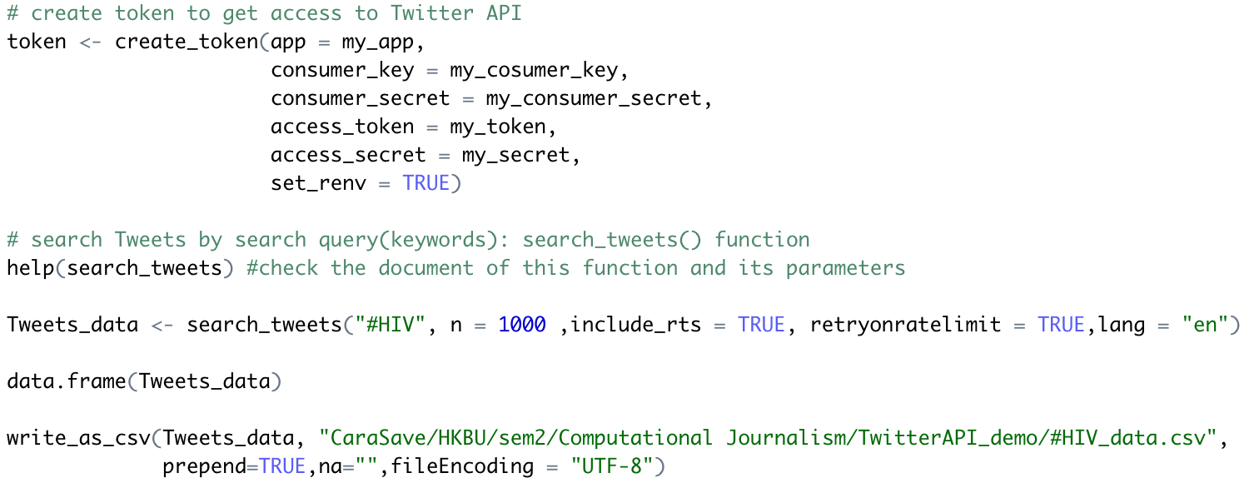
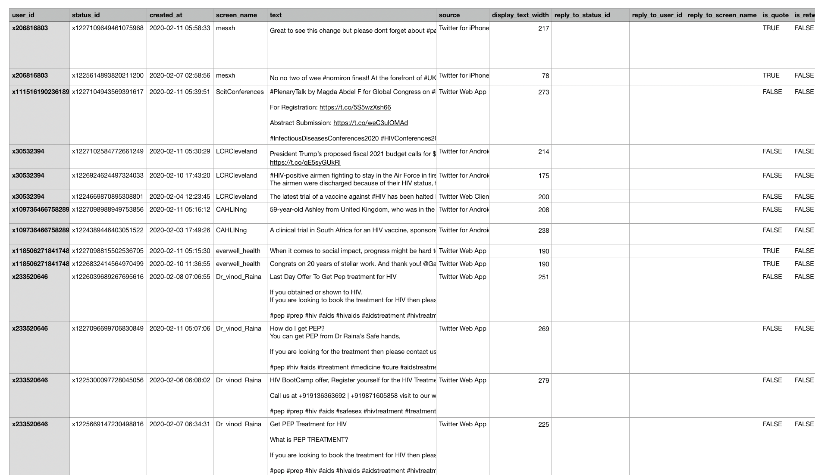
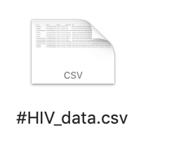
Step 2 - Data Collection:
By Twitter API
- Fast & Convenient
- Structured & Computer-readable

Slide 6
Step 3 Exploration
How ‘HIV’ is discussed in Twitter
- Exploration 1 Trend – in R
- Exploration 2 High frequent words – in R
- Exploration 3 Active users – in R
- Exploration 4 Popular tweets – in Python

